Slide 1
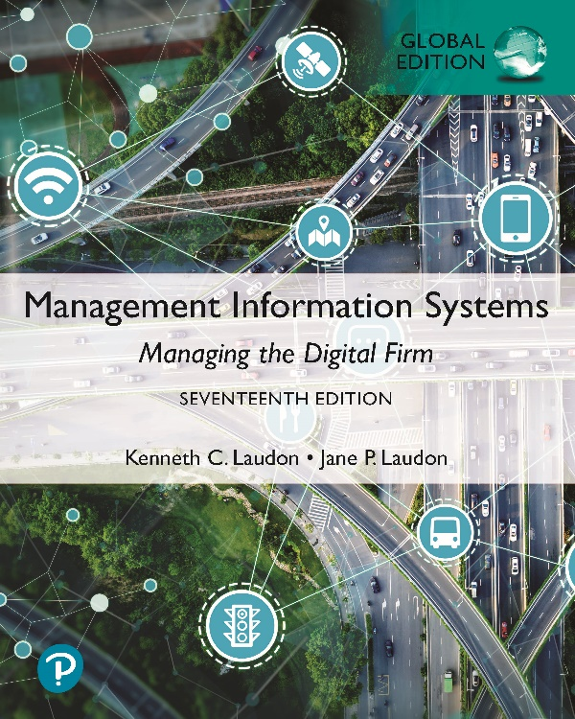
Management Information Systems: Managing the Digital Firm
Seventeenth Edition, Global Edition
Chapter 13
Building Information Systems
Copyright © 2022, 2020, 2018 Pearson Education, Ltd. All Rights Reserved
Notes:
If this PowerPoint presentation contains mathematical equations, you may need to check that your computer has the following installed:
1) MathType Plugin
2) Math Player (free versions available)
3) NVDA Reader (free versions available)

Slide 2
Learning Objectives
13.1 How does building new systems produce organizational change?
13.2 What are the core activities in the systems development process?
13.3 What are the principal methodologies for modeling and designing systems?
13.4 What are alternative methods for building information systems?
13.5 What are new approaches for system building in the digital firm era?
13.6 How will M I S help my career?
Notes:
This chapter discusses the kinds of organizational changes that result from the implementation of new information systems, the activities involved in systems development, and the various methodologies used to build information systems. Ask students to give their first impressions on how a new information system could produce organizational change. Give an example of a type of business and a new system, for example, a business that introduces an automated call-answering system to direct sales and technical inquiries to the right department. Ask students to discuss what types of organizational change this might bring about.

Slide 3
Video Cases
Case 1: I B M: Business Process Management in a S a a S Environment
Case 2: I B M Helps the City of Madrid with Real-Time B P M Software
Instructional Video 1: B P M Business Process Management Customer Story
Instructional Video 2: Workflow Management Visualized

Slide 4
Vinci Energies Builds a New Mobile Employee Time Sheet App (1 of 2)
Problem
  Inefficient manual processes
  Geographically dispersed organization
  Project-based business
  Rapid growth
Solutions
  Select system solution
  Monitor project
  Redesign timesheet reporting process
  SAP S/4 Hana; SAP Cloud Platform
  Mobile phones, tablets

Slide 5
Vinci Energies Builds a New Mobile Employee Time Sheet App (2 of 2)
New MOBTIME app
Demonstrates steps needed to design and build new information systems
Illustrates redesigning business processes as a part of system building

Slide 6
Systems Development and Organizational Change (1 of 2)
I T-enabled organizational change
Automation
  Increases efficiency
  Replaces manual tasks
Rationalization of procedures
  Streamlines standard operating procedures
  Often found in programs for making continuous quality improvements
    Total quality management (T Q M)
    Six Sigma
Notes:
This slide discusses the first two of four different types of organizational change that information systems can enable. You can ask students to give examples of each type of change within the context of an example of a business, for example, a pizza chain. Ask students to define TQM (makes achieving quality an end in itself) and Six Sigma (specific measure of quality—3.4 defects per million). Ask students to evaluate the two methods. Would one be better in some industries or types of businesses over the other method? Which method would be better for a restaurant chain? Which would be better for a clothing manufacturer? Why?

Slide 7
Systems Development and Organizational Change (2 of 2)
Business process redesign
  Analyze, simplify, and redesign business processes
  Reorganize workflow, combine steps, eliminate repetition
Paradigm shifts
  Rethink nature of business
  Define new business model
  Change nature of organization
Notes:
This slide discusses the third and fourth types of organizational change that information systems can enable. You can ask students to give examples of each type of change within the context of an example of a business, for example, a pizza chain. Or you can provide examples of change and ask students to determine what category that change falls into. An example of a paradigm shift is Schneider National which changed its business model from being a long-haul trucking and transportation firm to using its information systems to manage logistics for other companies.

Slide 8
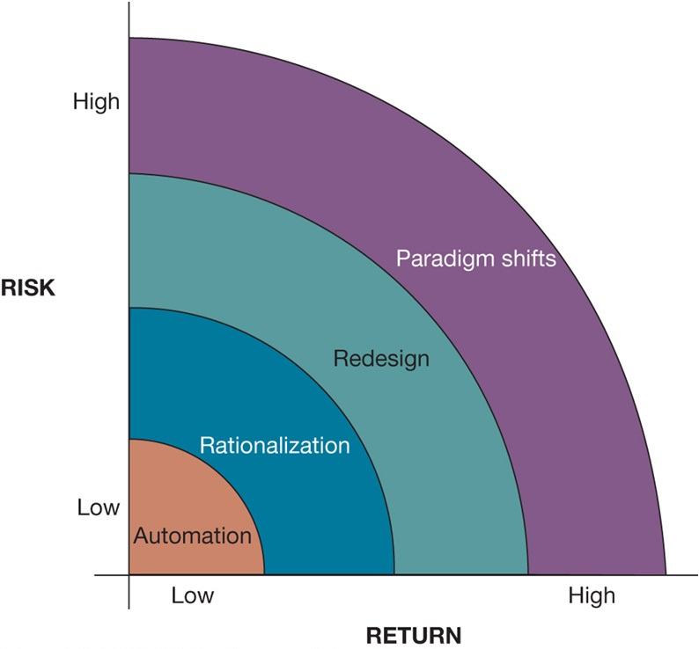
Figure 13.1 Organizational Change Carries Risks and Rewards
Notes:
Figure 13.1, Page 492.
The most common forms of organizational change are automation and rationalization. These relatively slow-moving and slow-changing strategies present modest returns but little risk. Faster and more comprehensive change—such as redesign and paradigm shifts—carries high rewards but offers substantial chances of failure.
This graphic illustrates the four types of change, identifying them according to the potential return on investment as well as level of risk. What makes automation a low risk? What makes a paradigm shift or redesign a high risk? It is important to note that BPR and paradigm shifts have high failure rates. Ask the students why this is so. (Organizational change is difficult to orchestrate.)
Alt Text
Long description: A graph plots four kinds of structural organizational changes enabled by information technology. The horizontal axis plots the return and the vertical axis plots the risk, both from low to high. The graph is in the form of a spectrum and marks organizational changes according to the risk and returns.
The spectrum of organizational change is composed of four parts, arranged from lowest to highest in terms of both risks and rewards are as below:
Automation
Rationalization
Redesign
Paradigm shift.

Slide 9
Interactive Session: Organizations: Business Process Redesign at DP World
Class discussion
  How did DP World’s previous processes affect its operations?
  Describe the role of AI and IoT in improving how DP World handles cargo.
  How would business process redesign enable digitized global trade?

Slide 10
Business Process Redesign
Business process management (B P M)
  Variety of tools, methodologies to analyze, design, optimize processes
  Used by firms to manage business process redesign
Steps in B P M
  Identify processes for change
  Analyze existing processes
  Design the new process
  Implement the new process
  Continuous measurement
Notes:
This slide emphasizes business process management, a category of tools and techniques that help firms redesign business processes, the riskiness of business process redesign, and the need to properly manage it in order for BPR to be effective. Ask students what the importance is of each step. For example, why it is important to determine the right business process to change rather than all business processes (some processes may not yield time or cost savings, you could spend too much money trying to improve all processes, and some processes may already be effective). Give students an example of a business process and ask how the process could be measured. For example, how would you measure the business process of a customer ordering a meal? Of a kitchen preparing and delivering that meal? What about the business process of hiring a new employee? It is important to note that, even with effective process redesign, a majority of reengineering projects do not achieve breakthrough gains because of inadequate change management.

Slide 11
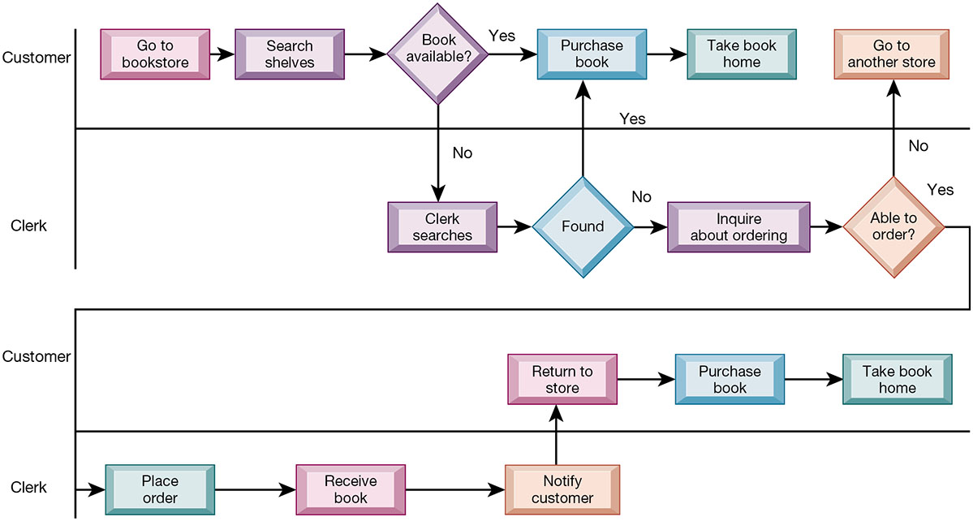
Figure 13.2 As-is Business Process for Purchasing a Book from a Physical Bookstore
Notes:
Figure 13.2, Page 496.
Purchasing a book from a physical bookstore requires many steps to be performed by both the seller and the customer.
This slide’s graphic illustrates the process of purchasing a book prior to reengineering, including the steps if a book is not available. It emphasizes the sequential nature of the task. Besides the time taken for this process, what are other disadvantages of this traditional business process?
Alt Text
Long description: A flowchart explains the steps involved in purchasing a book from a physical bookstore. The possible scenarios are as below:
The customer goes to a bookstore, searches shelves, if the book is available purchases the book and goes home.
If the book is not available the clerk searches it, if found the customer purchases the book and goes home.
If the book is not available and the clerk is unable to find it, the customer enquires about ordering:
If the clerk is able to order it he places the order, receives the book, and notifies the customer. The customer returns to the store purchases the book and goes home.
If the clerk is unable to order it the customer goes to another store.

Slide 12
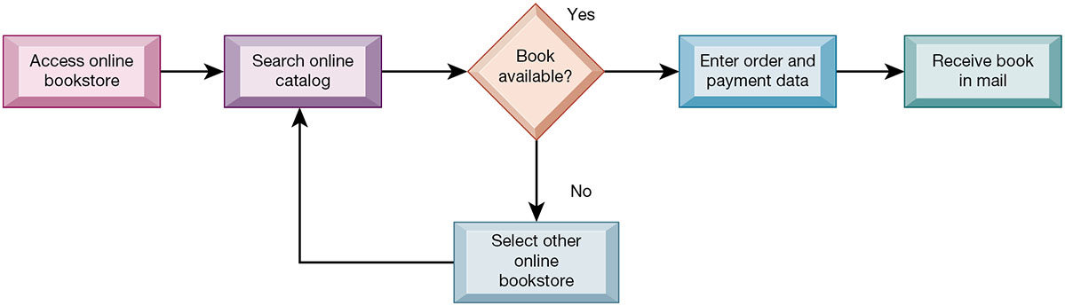
Figure 13.3 Redesigned Process for Purchasing a Book Online
Notes:
Figure 13.3, Page 496.
Using Internet technology makes it possible to redesign the process for purchasing a book so that it requires fewer steps and consumes fewer resources.
This graphic illustrates the book purchasing process after reengineering as an online process. The new process and technology has reduced numerous stages to four or five. What are the elements that have allowed these steps to occur? Which of the four types of organizational change described earlier does this redesigned process most closely resemble—automation, rationalization, redesign, paradigm shift?
Alt Text
Long description: A flow chart explains the steps involved in purchasing a book online. The details are as below:
Access online bookstore
Search online catalog
If the book is available, enter order and payment data and receive the book in mail
If the book is unavailable, select other online bookstore. If the book is available, enter order and payment data and receive the book in mail.

Slide 13
Tools for Business Process Management
Identify and document existing processes
  Identify inefficiencies
Create models of improved processes
Capture and enforce business rules for performing, automating processes
Integrate existing systems to support process improvements
Verify that new processes have improved
Measure impact of process changes on key business performance indicators
Notes:
This slide gives an overview of the various types of BPM tools that firms use to redesign business processes. The text discusses the example of American National Insurance Company, which used Pegasystems BPM workflow software to streamline customer service processes across four business groups. BPM built rules to guide service reps through a single view of customer information across multiple systems, eliminating the need to access multiple applications when handling customer requests. This increased workload capacity of the representatives by 192 percent.

Slide 14
Systems Development
Activities that go into producing an information system solution to an organizational problem or opportunity
  Systems analysis
  Systems design
  Programming
  Testing
  Conversion
  Production and maintenance
Notes:
This slide and the following slides discuss the activities involved in system development—the creation of a new (or improvements to an existing) information system. The activities listed are usually performed in order—the first two, systems analysis and systems design, are preparatory steps for the system. The last four steps translate the design of the system into actuality.
It is important to emphasize that an information system is not technology for technology’s sake, it is a solution to a problem or set of problems the organization perceives it is facing—including the problem of an opportunity that requires the use of information systems in order to undertake. What problems with business processes have students encountered or witnessed in their work or educational career that could have been improved with the help of a new or improved information system?

Slide 15
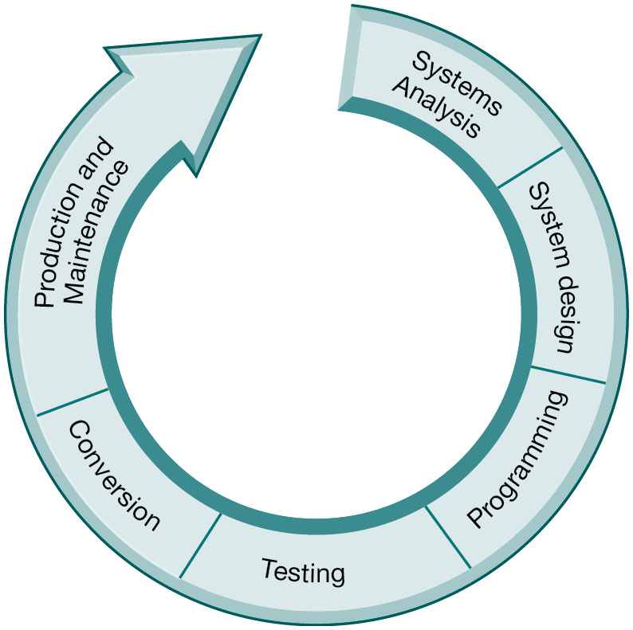
Figure 13.4 The Systems Development Process
Notes:
Figure 13.4, Page 498.
Building a system can be broken down into six core activities.
This graphic illustrates the six core activities of systems building. Ask students why these activities are represented as a circle.
The circular nature indicates that systems building is not a linear process that is finished once the system is built. Typically, additional changes and improvements will need to be made to the system or part of the system that will require additional analysis, design, programming, testing, conversion, and maintenance.
Alt Text
Long description: An illustration explains the six core activities of a traditional systems lifecycle. The details of the activities involved in building a system are as below:
Systems analysis
System design
Programming
Testing
Conversion
Production and maintenance.

Slide 16
Systems Analysis
Analysis of problem to be solved by new system
  Defining the problem
  Identifying causes
  Specifying solutions
  Identifying information requirements
Feasibility study
Systems proposal report
Information requirements
  Faulty requirements analysis is a leading cause of systems failure and high systems development costs
Notes:
This slide describes the first stage of systems development, systems analysis.
The systems analyst first creates a road map of the existing organization and systems. What does this road map consist of? (Identifying primary owners and users of data along with existing hardware and software.) What constitutes a primary owner of data? Ask students how an analyst would determine if a problem existed with existing systems. (He/she would examine documents, work papers, procedures, observe system operations, and interview key users as well as managers.)
What does it mean that a solution is feasible from a financial standpoint? A technical standpoint? An organizational standpoint?

Slide 17
Systems Design
Describes system specifications that will deliver functions identified during systems analysis
Should address all managerial, organizational, and technological components of system solution
Role of end users
  User information requirements drive system building
  Users must have sufficient control over design process to ensure system reflects their business priorities and information needs
  Insufficient user involvement in design effort is major cause of system failure
Notes:
This slide describes the second stage of systems development, systems design. The text explains that like houses or buildings, information systems may have many possible designs. Each design represents a unique blend of all technical and organizational components. What makes one design superior to others is the ease and efficiency with which it fulfills user requirements within a specific set of technical, organizational, financial, and time constraints. Given an identical systems analysis, what elements might be different in a system design created by two different systems designers?

Slide 18
Table 13.1 System Design Specifications (1 of 2)
Category | Specifications
Output | Medium, Content, Timing
Input | Origins, Flow, Data entry
User Interface | Simplicity, Efficiency, Logic, Feedback, Errors
Database Design | Logical data model, Volume and speed requirements, File organization and design, Record specifications
Processing | Computations, Program modules, Required reports, Timing of outputs
Manual Procedures | What activities, Who performs them, When, How, Where
Controls | Input controls (characters, limit, reasonableness), Processing controls (consistency, record counts), Output controls (totals, samples of output), Procedural controls (passwords, special forms)
Notes:
Table 13.1, Page 500.
This slide lists the various types of specifications that must be detailed and described in a systems design. From this it is easy to see how complex designing a system can be, and how many opportunities there are for mistakes to creep in. Problems in any one of these areas could produce a less-than optimal system and losses in efficiency and productivity. Select a few of the specifications here and ask students what types of problems could result from an inadequate definition of that specification.

Slide 19
Table 13.1 System Design Specifications (2 of 2)
Category | Specifications
Security | Access controls, Catastrophe plans, Audit trails
Documentation | Operations documentation, Systems documents, User documentation
Conversion | Transfer files, Initiate new procedures, Select testing method Cut over to new system
Training | Select training techniques, Develop training modules, Identify training facilities
Organizational Changes | Task redesign, Job redesign, Process design, Organization structure design, Reporting relationships
Notes:
Table 13.1 (continued), Page 500.

Slide 20
Completing the Systems Development Process (1 of 3)
Programming
  System specifications from design stage are translated into software program code
Testing
  Ensures system produces right results
  Unit testing: Tests each program in system separately
  System testing: Test functioning of system as a whole
  Acceptance testing: Makes sure system is ready to be used in production setting
  Test plan: All preparations for series of tests
Notes:
This slide describes the third and fourth stages of systems development, programming and testing.
Many companies today do not perform their own programming, but purchase software or outsource programming to a vendor. In outsourcing, who would be responsible for the testing, the vendor or the purchasing company? Would any testing be needed when software is purchased as a package? It is important to note that the importance of testing is typically underrated in systems project planning, and the risks resulting from inadequate testing are enormous. Ask students why, if system testing is performed that checks the entire system, would unit testing be important.

Slide 21
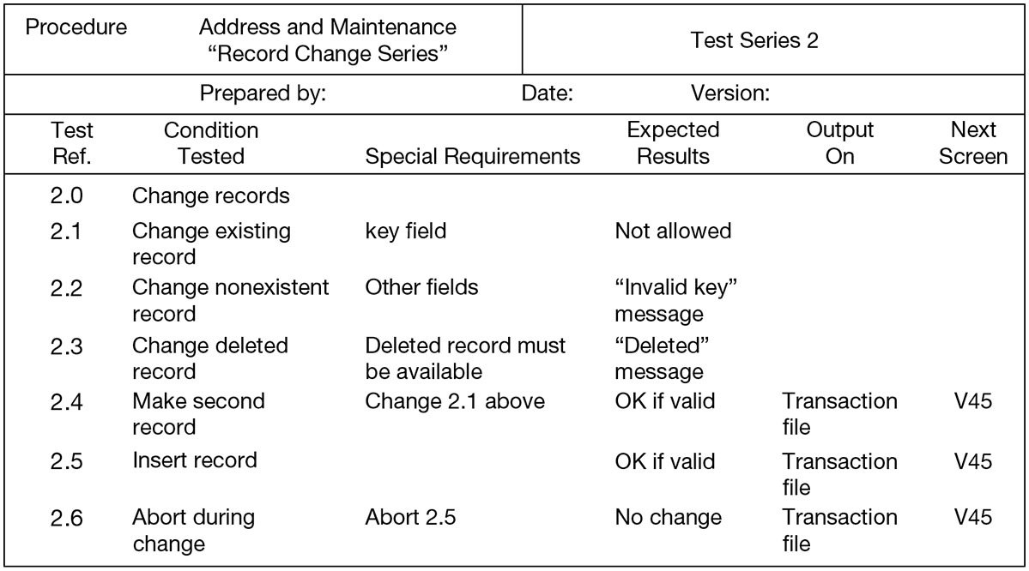
Figure 13.5 A Sample Test Plan to Test a Record Change
Notes:
Figure 13.5, Page 501.
When developing a test plan, it is imperative to include the various conditions to be tested, the requirements for each condition tested, and the expected results. Test plans require input from both end users and information systems specialists.
This graphic illustrates a portion of a test plan. Ask students to describe what the columns of this table mean. It looks at six different possible situations, given a user of the system attempting to change a record in the database, from trying to change an existing address in the system (2.1) to not completing the record change (2.6). Ask students what they understand about system testing from looking at this example.
Alt Text
Long description: A table records series of changes, while developing a test plan. The table includes the following details:
Procedure: Address and maintenance “Record change series” for test series 2.
There are blanks to input information in the following fields: Prepared by, date, and version.
Details corresponding to the test reference number, condition tested, special requirements, expected results, output on, and next screen are as below:
Test reference 2.0: Change records.
Test reference 2.1: Change existing records; Special requirements: key field; Expected results: Not allowed.
Test reference 2.2: Change nonexistent records; Special requirements: Other fields; Expected results: Invalid key message.
Test reference 2.3: Change deleted record; Special requirements: Deleted record must be available; Expected results: Deleted message.
Test reference 2.4: Make second record; Special requirements: Change 2.1 above; Expected results: OK if valid; Output on: Transaction file; Next screen: V45.
Test reference 2.5: Insert record; Special requirements: None; Expected results: OK if valid; Output on: Transaction file; Next screen: V45.
Test reference 2.6: Abort during change; Special requirements: Abort 2.5; Expected results: No change; Output on: Transaction file; Next screen: V45.

Slide 22
Completing the Systems Development Process (2 of 3)
Conversion
  Process of changing from old system to new system
  Four main strategies
    Parallel strategy
    Direct cutover
    Pilot study
    Phased approach
  Requires end-user training
  Finalization of detailed documentation showing how system works from technical and end-user standpoint
Notes:
This slide describes the fifth stage of systems development, conversion. Ask students to describe each of the strategies. What would make one approach more appropriate than another? Is there any case in which a direct cutover would be the optimal strategy?

Slide 23
Completing the Systems Development Process (3 of 3)
Production and maintenance
  System reviewed to determine if revisions needed
  May include post-implementation audit document
  Maintenance
    Changes in hardware, software, documentation, or procedures to a production system to correct errors, meet new requirements, or improve processing efficiency
Notes:
This slide describes the sixth and final stage of systems development, production and maintenance, and shows that an information system is never “finished.” Situations and business environments always change, and systems have to change along with the business. Of course, many businesses do not want to spend the resources to change their systems as required by a changing environment. And for this reason, systems can become dysfunctional, costing the firm money fixing the problems created by an outdated system. Ask students to discuss if any of the types of maintenance work listed here could be eliminated by better analysis and design?

Slide 24
Table 13.2 Systems Development
Core Activity | Core Activity
Systems analysis | Identify problem(s), Specify solutions, Establish information requirements
Systems design | Create design specifications
Programming | Translate design specifications into program code
Testing | Perform unit testing, Perform systems testing, Perform acceptance testing
Conversion | Plan conversion, Prepare documentation, Train users and technical staff
Production and maintenance | Operate the system, Evaluate the system, Modify the system
Notes:
Table 13.2, Page 502.
This slide summarizes the six stages in system development. Ask students what the difference is between information requirements and design specifications.

Slide 25
Structured Methodologies (1 of 3)
Structured: Techniques are step-by-step, progressive
Process-oriented: Focusing on modeling processes or actions that manipulate data
Separate data from processes
Notes:
This slide introduces the core concepts behind a structured methodology, a prominent methodology for modeling systems. Ask students what a process is or to give an example of a process. What does it mean to “separate data from processes”?

Slide 26
Structured Methodologies (2 of 3)
Data flow diagram
  Represents system’s component processes and flow of data between them
  Logical graphic model of information flow
Data dictionary
  Defines contents of data flows and data stores
Notes:
This slide continues the discussion of structured methodologies, looking at the tools and techniques that it uses to model an information system. An example data flow diagram is shown on the next slide, so it may be helpful to move to that slide to discuss these diagrams. A data dictionary is needed so that system builders know exactly what data is stored and manipulated. Process specifications express the logic that is used when one piece of data is transformed by a process.

Slide 27
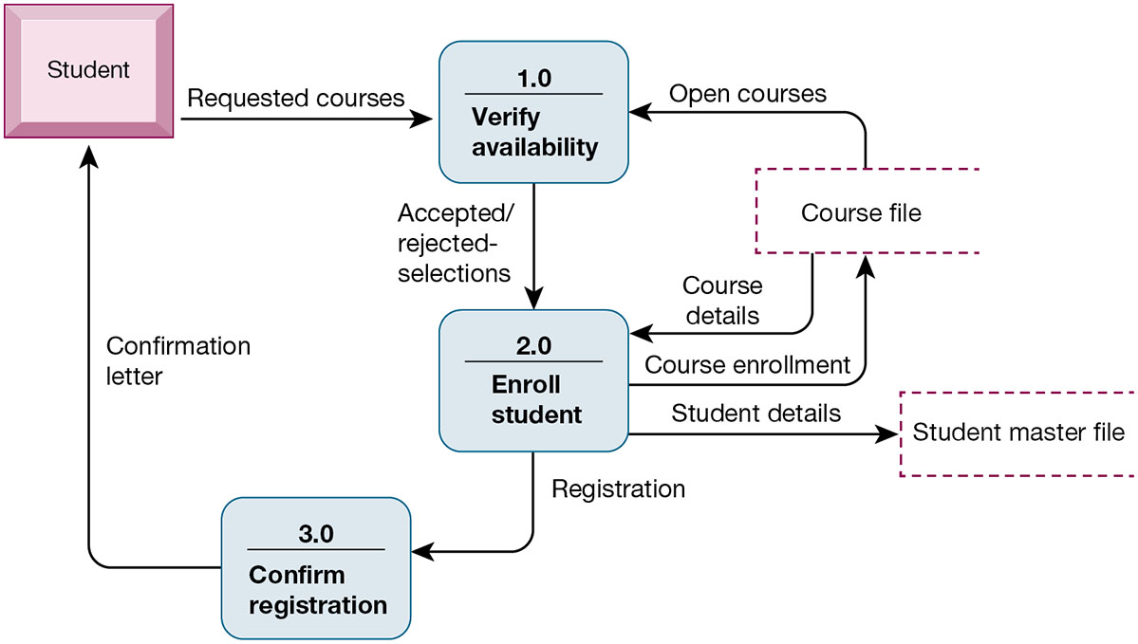
Figure 13.6 Data Flow Diagram for Mail-in University Registration System
Notes:
Figure 13.6, Page 504.
The system has three processes: Verify availability (1.0), Enroll student (2.0), and Confirm registration (3.0). The name and content of each of the data flows appear adjacent to each arrow. There is one external entity in this system: the student. There are two data stores: the student master file and the course file.
This graphic is a data flow diagram. Ask students what the rounded boxes represent (processes) and what the square box represents (an external entity). What about the open rectangle and the arrows? Where does the process begin? Ask a student to step through the process of registering a student for a course, noting what data is transferred at each step. It’s always fun to do data flow diagrams as a group because it illustrates how the same process is seen differently by different people.
Alt Text
Long description: A data flow diagram explains a student registration process through three processes. The details of the flow are as follows, when the student requests for courses:
Process 1.0 is to verify availability.
Process 2.0 is to enroll student after accepting or rejecting selections
Process 3.0 is to confirm registration after registration, send confirmation letter to the student.
The availability is verified from the course file, if there are open courses. The course file also provides course details necessary for process 2.0. it also aids in course enrollment and sends the student details to the student master file.

Slide 28
Structured Methodologies (3 of 3)
Process specifications
  Describe transformation occurring within lowest level of data flow diagrams
Structure chart
  Top-down chart, showing each level of design, relationship to other levels, and place in overall design structure
Notes:
This slide continues the discussion of structured methodologies, looking at the tools and techniques that it uses to model an information system. Process specifications express the logic that is used when one piece of data is transformed by a process. A structure chart looks at the main function of the system, breaks it down into subfunctions, breaks subfunctions into more detailed subfunctions, until the smallest level of detail is reached. Ask students to give an example of what the smallest level of detail might look like, for example, in a university system managing student grades and reports.

Slide 29
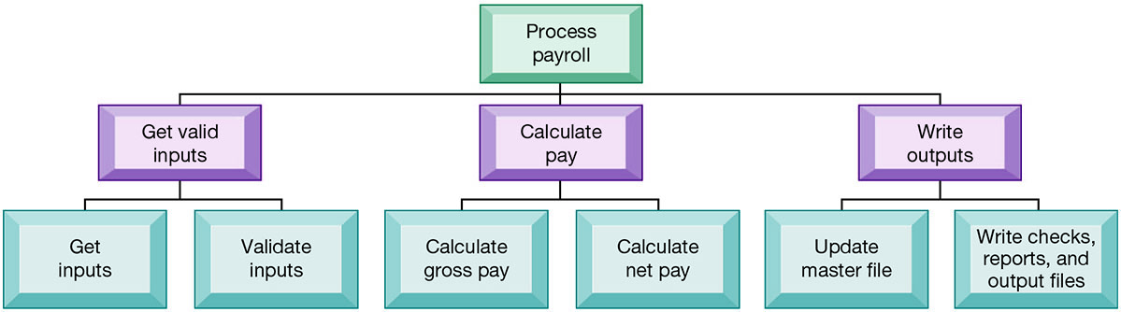
Figure 13.7 High-level Structure Chart for a Payroll System
Notes:
Figure 13.7, Page 505.
This structure chart shows the highest or most abstract level of design for a payroll system, providing an overview of the entire system.
This graphic shows a high-level structure chart. Note that this is high-level—and subfunctions exist for the functions “Get inputs,” “Validate inputs,” and so on. What might be a subfunction for “Calculate gross pay”?
Alt Text
Long description: A hierarchical chart explains the process of a payroll system. The details are as below from top to bottom:
Process payroll
Get valid inputs: Get and validate inputs
Calculate pay: Calculate gross and net pay
Write outputs: Update master file and write checks, reports, and output files.

Slide 30
Object-Oriented Development (1 of 2)
Object
  Basic unit of systems analysis and design
  Combines data and the processes that operate on those data
  Data in object can be accessed only by operations associated with that object
Object-oriented modeling
  Based on concepts of class and inheritance
  Objects belong to a certain class and have features of that class
  May inherit structures and behaviors of a more general, ancestor class
Notes:
This slide introduces the second of the two main system modeling methodologies—object-oriented development. A key concept here is that of class and inheritance. Ask students what a class is (general category of similar objects) and to describe objects that might be in the same class. For example, what objects might be in the category “Degrees” in a university’s information system?

Slide 31
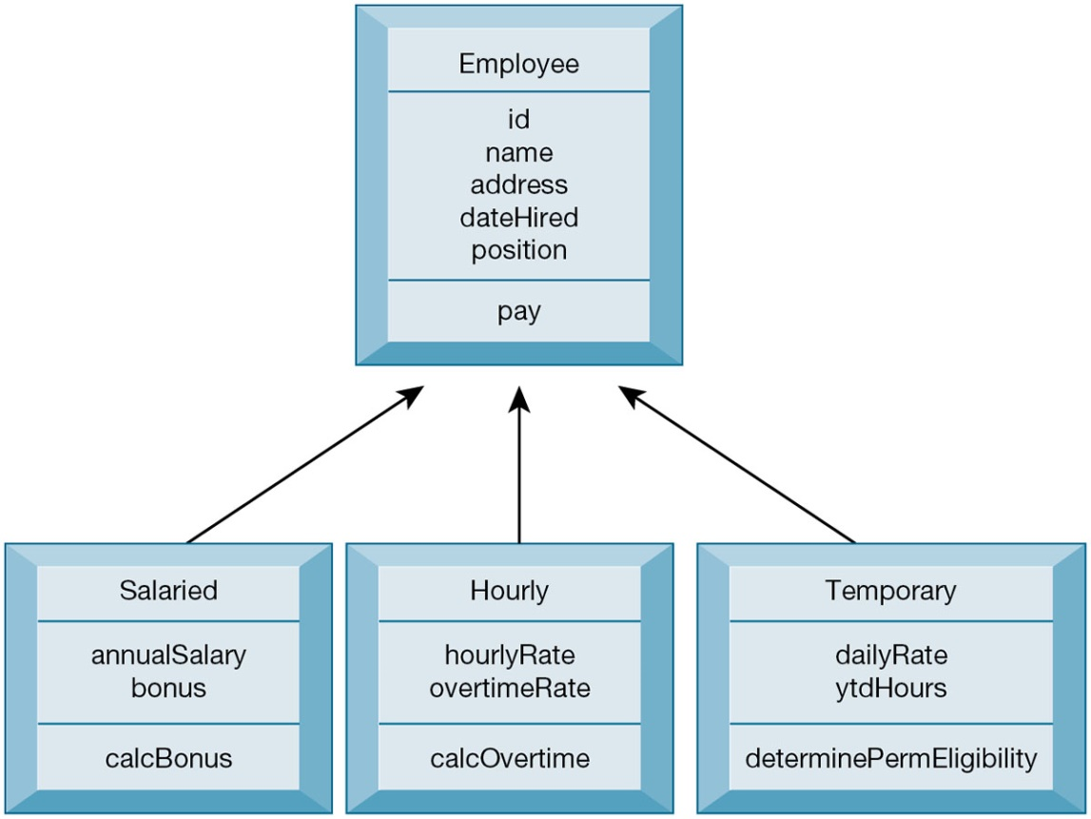
Figure 13.8 Class and Inheritance
Notes:
Figure 13.8, Page 506.
This figure illustrates how classes inherit the common features of their superclass.
This graphic illustrates the concept of class and inheritance in object-oriented development. The Class employee allows subclasses to be created using the “template” or superclass “Employee” and use the processes and properties defined for Employee. Subclasses can use properties of their superclass and also add their own properties. If a subclass “Intern” was added to this chart, what unique properties might it have?
Alt Text
Long description: A converging flow diagram explains how classes inherit the common features of their superclass.
The details of the super class are as follows:
Employee: ID, name, address, date hired, position, and pay.
The details of the classes are as follows:
Salaried: Annual salary bonus; Calculate bonus.
Hourly: Hourly rate and overtime rate; Calculate overtime.
Temporary: Daily rate and YTD hours; Determine permanent eligibility.

Slide 32
Object-Oriented Development (2 of 2)
More iterative and incremental than traditional structured development
  Systems analysis: Interactions between system and users analyzed to identify objects
  Design phase: Describes how objects will behave and interact; grouped into classes, subclasses, and hierarchies
  Implementation: Some classes may be reused from existing library of classes, others created or inherited
Objects are reusable
  Object-oriented development can potentially reduce time and cost of development
Notes:
This slide continues the discussion of object-oriented development, highlighting unique considerations during the systems development process. Ask students to perform some rudimentary systems analysis and design for an information system that managed inventory for a department store. What classes might be created? What properties would they have? What subclasses would there be for one of these classes and what properties would they inherit?
It is important to emphasize that object-oriented development can reduce the time and cost of development through reusing objects and classes from one application for other applications.

Slide 33
Traditional Systems Life Cycle
Oldest method for building information systems
Phased approach
  Development divided into formal stages
  “Waterfall” approach: One stage finishes before next stage begins
Formal division of labor between end users and information systems specialists
Emphasizes formal specifications and paperwork
Still used for building large complex systems
Can be costly, time-consuming, and inflexible
Notes:
This slide describes the traditional systems life cycle method of building systems. Ask students what the effects of unanticipated user requirements are when using this type of building method. What is the role of end users in this method? What happens when users change their minds halfway through the project? Can the systems analysis be started over?

Slide 34
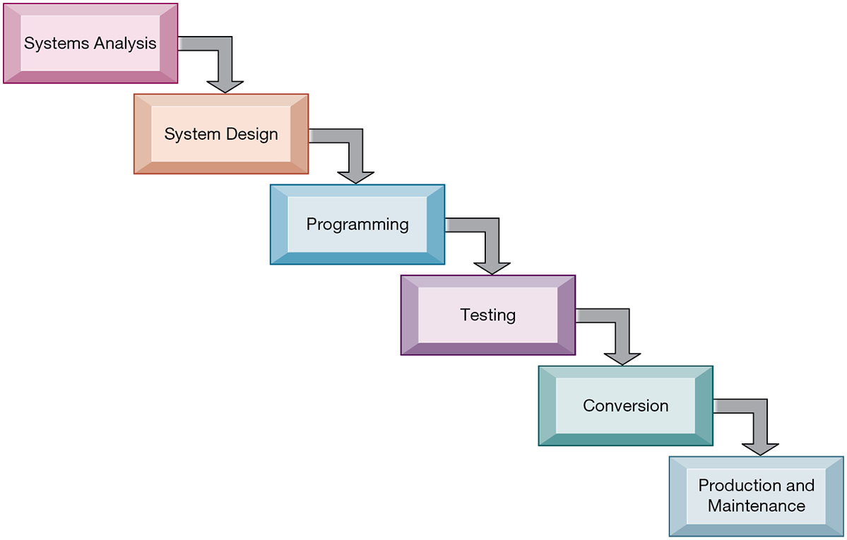
Figure 13.9 The Traditional Systems Development Life Cycle
Notes:
Figure 13.9, Page 507.
The systems development life cycle partitions systems development into formal stages, with each stage requiring completion before the next stage can begin.
Alt Text
Long description: A step diagram explains the various stages of a traditional systems life cycle. The details are as below:
Systems analysis
System design
Programming
Testing
Conversion
Production and maintenance.

Slide 35
Prototyping (1 of 2)
Building experimental system rapidly and inexpensively for end users to evaluate
Prototype: Working but preliminary version of information system
  Approved prototype serves as template for final system
Steps in prototyping
  Identify user requirements
  Develop initial prototype
  Use prototype
  Revise and enhance prototype
Notes:
This slide discusses the prototyping method of systems building. Prototyping is an explicitly iterative process. The term iterative has been used several times; ask students to describe what this means (steps to build the system can be repeated over and over). What are the benefits of an iterative process?
Note that once no more iterations are needed, the prototype becomes the finished specifications for the final application, or may serve as the production version of the application.

Slide 36
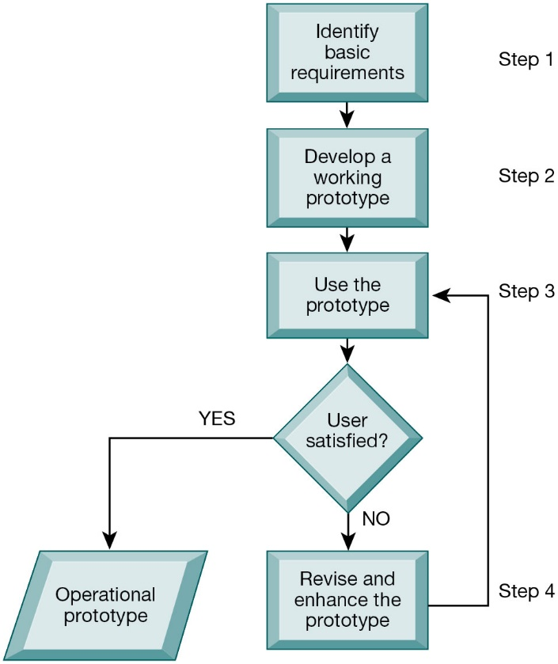
Figure 13.10 The Prototyping Process
Notes:
Figure 13.10, Page 509.
The process of developing a prototype can be broken down into four steps. Because a prototype can be developed quickly and inexpensively, systems builders can go through several iterations, repeating steps 3 and 4, to refine and enhance the prototype before arriving at the final operational one.
This graphic illustrates the four steps (rectangles) of prototyping. The steps that are repeated are steps 3) use the prototype and 4) revise and enhance the prototype. Would this type of system development be appropriate for developing a large, enterprise management system?
Alt Text
Long description: A flowchart explains the steps involved in the process of developing a prototype. The details are as below:
Step 1: Identify basic requirements
Step 2: Develop a working prototype
Step 3: Use the prototype. If the user is satisfied it becomes an operational prototype.
Step 4: If the user is not satisfied after the use of the prototype, revise and enhance the prototype and go back to step 3.

Slide 37
Prototyping (2 of 2)
Advantages of prototyping
  Useful if some uncertainty in requirements or design solutions
  Often used for end-user interface design
  More likely to fulfill end-user requirements
Disadvantages
  May gloss over essential steps
  May not accommodate large quantities of data or large number of users
    May not undergo full testing or documentation
Notes:
This slide continues the discussion of prototyping, listing the advantages and disadvantages to using this method of building systems.
Ask students to explain these advantages and disadvantages. For example, why is prototyping useful if there is uncertainty in requirements? What kinds of essential steps might be glossed over?

Slide 38
Application Software Packages, Software Services, and Outsourcing (1 of 3)
Application software packages and software services
  Save time and money
  Many packages offer customization features
Evaluation criteria for systems analysis include:
  Functions provided, flexibility, user friendliness, required resources, database requirements, installation and maintenance efforts, documentation, vendor quality, and cost
Request for Proposal (R F P)
  Detailed list of questions submitted to software vendors
  Used to evaluate alternative software packages and cloud software services
Notes:
This slide discusses another alternative in systems building, the use of application software packages and cloud software services. It is important to note that many functions are common to all business organizations—payroll, accounts receivable, or inventory control. Software packages or cloud software services may fulfill the need for many organizations for these types of functions. However, it is still important to perform systems analysis in order to determine your organization’s requirements for a system. Step through and explain (or have students explain) the evaluation criteria. For example, you would want to outline the functions you need from the software and determine whether the software or service provides that.

Slide 39
Application Software Packages, Software Services, and Outsourcing (2 of 3)
Outsourcing: several types
  Cloud and S a a S providers: subscribing companies use software and hardware provided by vendors
  External vendors
    Hired to design, create software
    Domestic outsourcing
      Driven by firm’s need for additional skills, resources, assets
    Offshore outsourcing
      Driven by cost-savings
Notes:
This slide describes outsourcing, yet another alternative in systems building. SaaS and cloud computing were introduced in Chapter 5. Have students describe these types of outsourcing in their own words.

Slide 40
Application Software Packages, Software Services, and Outsourcing (3 of 3)
Outsourcing Advantages/Disadvantages
  Advantages: Allows organization flexibility in I T needs
  Disadvantages
    Hidden costs, for example:
      Identifying and selecting vendor
      Transitioning to vendor
    Opening up proprietary business processes to third party
Notes:
This slide continues the discussion of outsourcing. It is important to emphasize the amount of work involved in partnering and sharing work with a vendor. It may take anywhere from three months to a year to fully transfer work to a vendor. What other types of hidden costs can students identify?

Slide 41
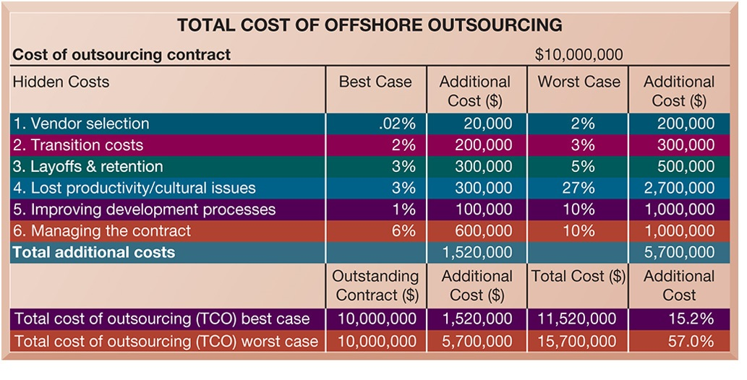
Figure 13.11 Total Cost of Offshore Outsourcing
Notes:
Figure 13.11, Page 511.
If a firm spends $10 million on offshore outsourcing contracts, that company will actually spend 15.2 percent in extra costs even under the best-case scenario. In the worst-case scenario, where there is a dramatic drop in productivity along with exceptionally high transition and layoff costs, a firm can expect to pay up to 57 percent in extra costs on top of the $10 million outlay for an offshore contract.
This graphic looks at the best- and worst-case scenarios regarding hidden costs in outsourcing. The best-case column shows the lowest estimates for additional costs, and the worst case reflects the highest estimates for these costs. In the Additional Cost column at the lower right, you can see that hidden costs increase the total cost of an offshore outsourcing project by an extra 15 to 57 percent. However, it is important to note that even with these extra hidden costs, many firms will benefit from offshore outsourcing if they manage the work well.
Alt Text
Long description: A table summarizes the total cost of offshore outsourcing. Cost of outsourcing contract: $10,000,000.
The details of various hidden costs and their corresponding best-case percentage, additional cost, worst case percentage, and additional cost are given below:
Vendor selection: Best case: .02%; Additional cost: $20,000; Worst case: 2%; Additional cost: $200,000.
Transition costs: Best case: 2%; Additional cost: $200,000; Worst case: 3%; Additional cost: $300,000.
Layoffs and retention: Best case: 3%; Additional cost: $300,000; Worst case: 5%; Additional cost: $500,000.
Lost productivity and cultural issues: Best case: 3%; Additional cost: $300,000; Worst case: 27%; Additional cost: $2,700,000.
Improving development processes: Best case: 1%; Additional cost: $100,000; Worst case: 10%; Additional cost: $1,100,000.
Managing the contract: Best case: 6%; Additional cost: $600,000; Worst case: 10%; Additional cost: $1,100,000.
Total additional costs: Best case: NA; Additional cost: $1,520,000; Worst case: NA; Additional cost: $5,700,000.
Total cost of outsourcing best case: Outstanding contract, $10,000,000; Additional cost: $1,520,000; Total cost: 11,520,000; Additional cost: 15.2%.
Total cost of outsourcing worst case: Outstanding contract, $10,000,000; Additional cost: $15,700,000; Total cost: 11,520,000; Additional cost: 57.0%.

Slide 42
Rapid Application Development (R A D), Agile Development, Automated Software Testing, and DevOps (1 of 3)
Rapid application development (R A D)
  Process of creating workable systems in a very short period of time
Joint application design (J A D)
  Used to accelerate generation of information requirements and to develop initial systems design
Notes:
This and the following two slides discuss application development methods that emphasize providing fast solutions needed in an increasingly digital world. What elements in RAD are similar to building methods already discussed and used in other forms of application development, such as prototyping?

Slide 43
Rapid Application Development (R A D), Agile Development, Automated Software Testing, and DevOps (2 of 3)
Agile development
  Focuses on rapid delivery of working software by breaking large project into subprojects that can be completed in short periods of time
Automated software testing
  Tools to perform examinations of software, report outcomes, compare results with earlier test runs
DevOps
  Builds on agile development principles as an organizational strategy
Notes:
The slide continues the discussion of application development methods that emphasize providing fast solutions needed in an increasingly digital world.

Slide 44
Interactive Session: Technology: McAfee Turns to Automated Software Testing
Class discussion
  Why would a company such as McAfee benefit from automated software testing?
  What management, organization, and technology factors did McAfee address in moving to automated software testing?
  Was Worksoft Certify a good solution for McAfee? Why or why not?
  How did automated software testing change the way McAfee ran its business.

Slide 45
Rapid Application Development (R A D), Agile Development, Automated Software Testing, and DevOps (3 of 3)
Low-code development
  Enables faster development of applications, with minimal hand-coding, using visual modelling in a graphical interface
No-code development
  Includes built-in tools that enable user to create apps without any coding
  Some disadvantages
    Have limited functionality
    Users can create applications without proper management oversight

Slide 46
Mobile Application Development
Mobile websites
Mobile web apps
Native apps
Special requirements for mobile platform
  Smaller screens, keyboards, multitouch gestures, saving resources (memory, processing)
Responsive web design
  Websites programmed so that layouts change automatically according to user’s computing device
Notes:
The fastest growing business platform is the mobile tablet and smartphone platform. Rebuilding old applications for delivery on the new platform is an expensive challenge for many businesses. All the large enterprise software firms (Oracle, IBM, and SAP) have adapted their legacy software to the mobile platform (for the most part). All new application development is aimed as multiplatform delivery on the desktop, tablet, and smartphone.

Slide 47
How Will MIS Help My Career?
The Company: Systems 100 Technology Consultants
Position Description: Entry-level junior business systems analyst
Job Requirements
Interview Questions
Author Tips
Notes:
A good opportunity for a class discussion of the section on careers. Would any in the class be interested in a job like this? What do they think are the most important skills the employer is looking for? How would they answer the interviewer questions?

Slide 48

Copyright
This work is protected by United States copyright laws and is provided solely for the use of instructors in teaching their courses and assessing student learning. Dissemination or sale of any part of this work (including on the World Wide Web) will destroy the integrity of the work and is not permitted. The work and materials from it should never be made available to students except by instructors using the accompanying text in their classes. All recipients of this work are expected to abide by these restrictions and to honor the intended pedagogical purposes and the needs of other instructors who rely on these materials.

